Slide 1
Subject Name: Introduction to Web Technology Module Number: 1 Dr. Amrendra Singh Yadav

Slide 2
CONTENTS
Introduction to Internet
Internet Design Principles
Internet Protocols
World Wide Web
Hyper Text Transfer Protocol
Web Technologies and Web Services

Slide 3
Client and Server
Client – hardware/software that accesses a service made available by a server.
Server – hardware/software that provides services to other users.
Client
Client
Server
Request
Client
Client
Reply
Notes:
Source: https://community.rti.com/static/documentation/connext-dds/5.2.0/doc/manuals/connext_dds/html_files/RTI_ConnextDDS_CoreLibraries_GettingStarted/Content/UsersManual/Network_Communications_Models.htm

Slide 4




Client Server Analogy
Server is like waiter
Clients are like customers
-Asks the server for food
-Not allowed in to the kitchen
Notes:
Source: http://slideplayer.com/slide/8879753/

Slide 5
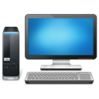
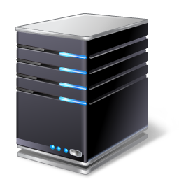
Client Server Communication
The process of establishing a connection between a client and a server is called as Client-Server Communication
The Internet uses the Client-Server model.
The browser send a URL
Server
Client
The server send html a page
Notes:
Source: https://www.slideshare.net/priyankanaik965/client-server-communication-using-java-servlets

Slide 6
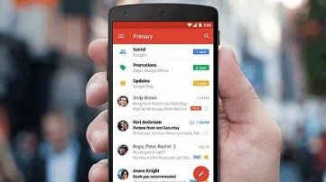
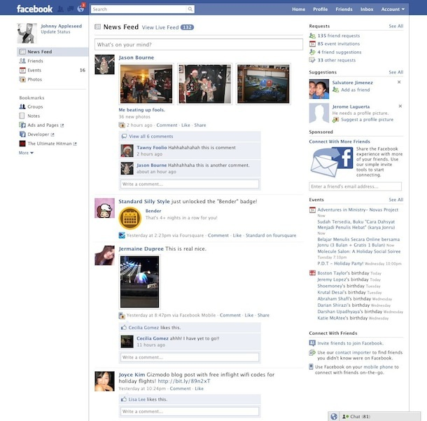
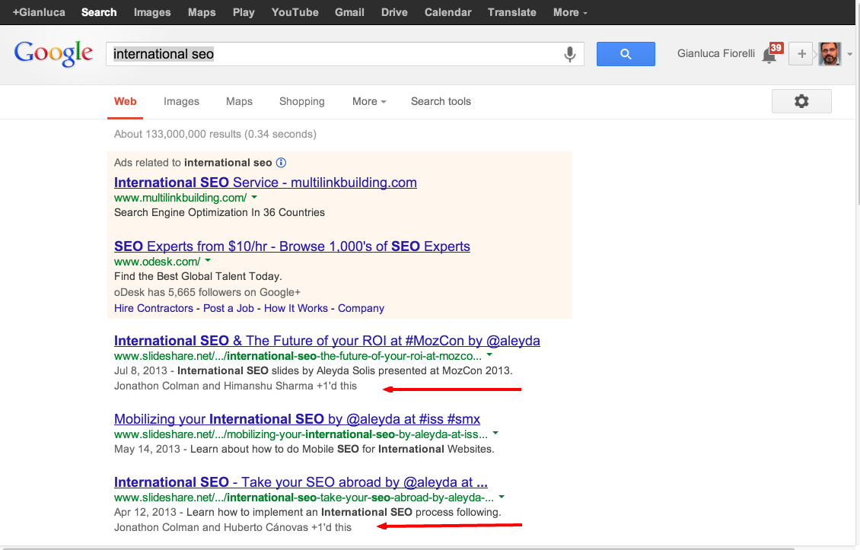
Have you sent an email to a friend living in United States?
Have you connected with friends all over the world on Facebook?
Have you searched something on the internet?

Slide 7
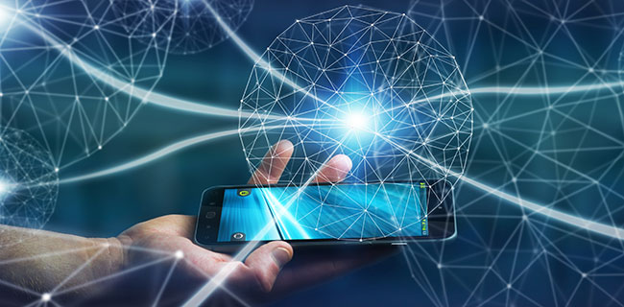
How is it possible for you to communicate with a friend who might be on a different continent?
You and your friend both need to be connected to the internet to be able to do all these things.

Slide 8
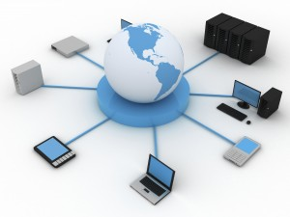
So What is Internet?
Internet is a global network of interconnected networks and devices that exchange information.

Slide 9
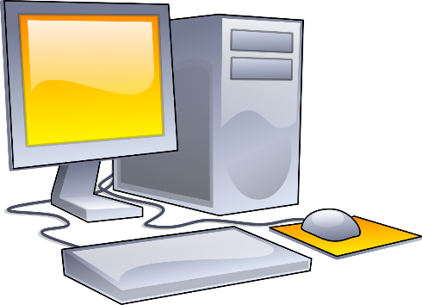
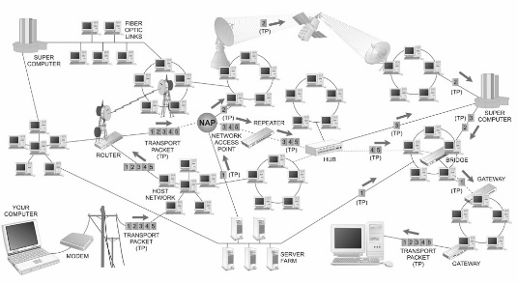
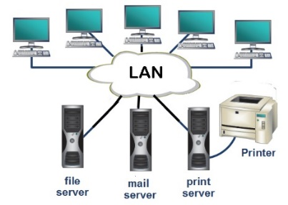
Evolution of Internet
Standalone Computers
When computers were first created they were stand alone.
Networks
The need for sharing resources among the computers led to connecting computers into a network.
Inter-network
These networks were then connected together to create what is today called the ‘Internet’.
Need for sharing resources led to the creation of networks and ultimately the ‘Internet’.
Internet – How it came to be?

Slide 10
History of Internet
The Advanced Research Projects Agency Network or ARPANET funded by the United States Department of Defense in 1969.
In 1971 Ray Tomlinson developed a system to send electronic mail.
Dr. Robert M. Metcalfe developed Ethernet in 1973.
In the early 80s the, the current versions of Transmission Control Protocol (TCP) and IP (Internet Protocol) were developed.
In 1992, The Computer Emergency Rescue Team (CERT) released the first version of the “World Wide Web”.
In 1996, IPV6 – Internet Protocol Version 6 was created.
In 1999, a wireless technology called 802.11b or popularly known as “Wi-Fi” was standardized.

Slide 11
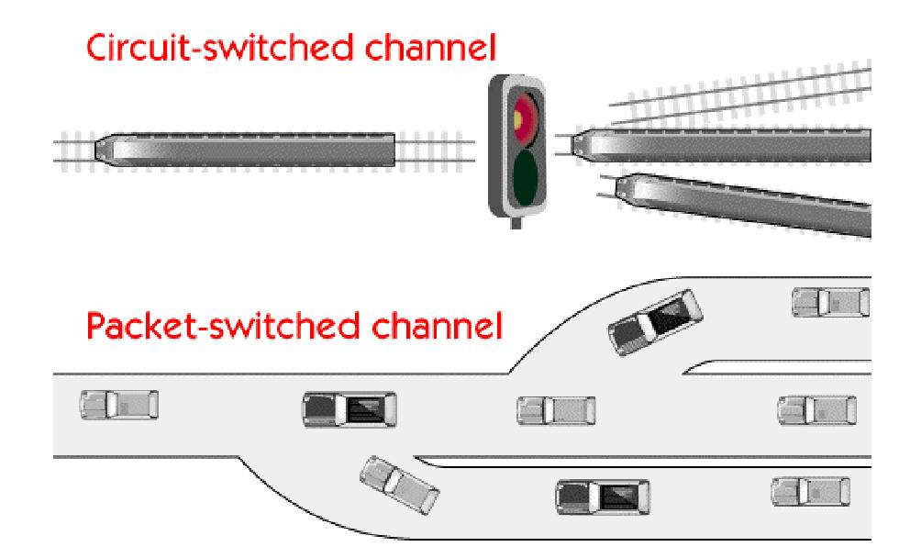
History of Internet
The Beginning
In 1964, when Packet Switching was invented it opened the doors for computers to connect and communicate.
Unlike Circuit Switching, which required a dedicated channel for the duration of transmission, packet switching divided the data into small parts called ‘packets’ which were then transmitted over the network.
Notes:
Circuit switching and packet switching are switching methods for connecting multiple communicating devices. Circuit communication is more suited for voice transmission but less suited for data transmission . An alternative and better solution for data transmission evolved called packet switching.
An Analogy:
Circuit switching can be understood by comparing it to a train and a train line. The data in a circuit switch is the train whereas the physical medium is the train.
Before using the line the train (data) should request for access.
Once granted, it can move on this line. But it holds an exclusive access to the line and no other train can access the line while our train is there.
Though circuit switching allows guaranteed bandwidth, it has the overhead of asking and being granted permission and the added disadvantage of under utilization of the physical medium. Telephone lines are best example for circuit switching.
For Packet switching, imagine data as cars and physical medium as the motorway.
Data is not sent as a big chunk, rather broken into small packets and sent over the same channel being used by many other users.
There’s no access permission required, we simply jump onto the car and go.
Besides the channel utilization is very good since many cars can travel on the same motorway at the same time.
However, there is no guaranteed bandwidth, if too many cars use the motorway at the same time it would crowd and eventually stop.
Source: https://assignmentlanka.wordpress.com/2009/08/17/packet-switched-vs-circuit-switched/

Slide 12
History of Internet
Advanced Research project Agency Network (ARPANET) – ancestor of today’s Internet.
The American Defense Advance Research Projects Agency (DARPA) was ordered by the American government to create a network spanning the United States so that information exchange could be ensured during a potential atomic attack by USSR.
The network that was developed was called the ‘ARPANET’ short for Advanced Research project Agency Network.
It was a basic network based on packet switching and providing messaging services for sharing information. By 1977, over a 100 nodes were connected through ARPANET.

Slide 13
History of Internet
Electronic Mail – the initial networking application
In 1972, the initial network application – the electronic mail was introduced.
March Ray Tomlinson wrote the basic email software motivated by the need of the ARPANET users for an easy and better coordination mechanism.
Email remained the largest network application for over a decade.
The commonly used email protocols are :
Simple Mail Transfer Protocol (SMTP) used for sending email messages.
Post Office Protocol (POP) used for retrieving email messages.
Notes:
The term Ethernet refers to the family of local area network (LAN) implementations that includes three principal categories:
Ethernet and IEEE 802.3---LAN specifications that operate at 10 Mbps over coaxial cable.
100-Mbps Ethernet---A single LAN specification, also known as Fast Ethernet, that operates at 100 Mbps over twisted-pair cable.
1000-Mbps Ethernet---A single LAN specification, also known as Gigabit Ethernet, that operates at 1000 Mbps (1 Gbps) over fiber and twisted-pair cables.

Slide 14
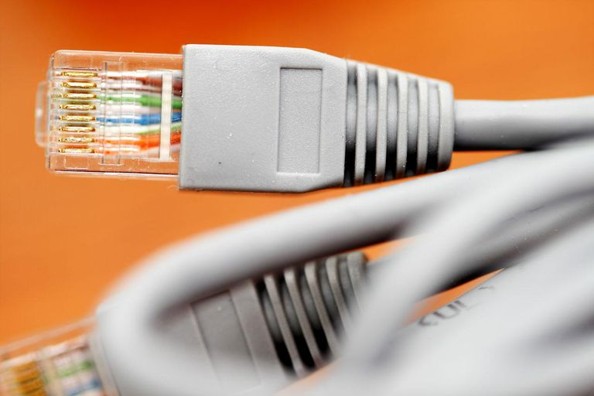
History of Internet
Ethernet – the network technology is born
Developed by Bob Metcalfe at Xerox PARC in 1973, and is now a dominant network technology in the Internet.
Ethernet is a relatively low cost, reasonably fast and very popular LAN technology.
Ethernet Cable

Slide 15
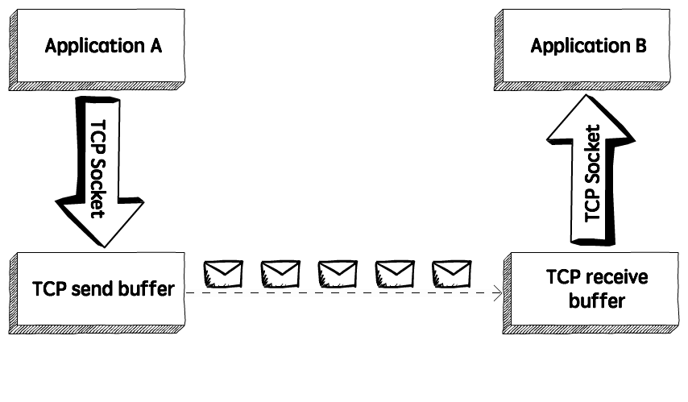
History of Internet
ARPANET adopts Transmission Control Protocol (TCP/IP)
In 1974, ARPANET adopted the TCP/IP protocol created by Robert Kahn and Vint Cerf. By mid 70s.
Exchange of Data on TCP
Notes:
ARPANET was not the only network at this time around. A lot of similar networks had popped up all around the world. And thanks to TCP/IP the exchange of data packets between different networks was made possible. As a result different networks connected to form one big network.
Transmission Control Protocol:
When a user sends or retrieves information across the Internet – e.g., access Web pages or upload files to a server - the TCP on the sender’s machine breaks the message into packets and sends them out.
The IP is the part of the protocol concerned with “the addressing and forwarding” of those individual packets. The IP is a critical part of our daily Internet experience: without it, it would be practically impossible to locate the information we are looking for among the billions of machines connected to the network today.
In TCP/IP each host on the internet is given a unique numeric address called the ‘Internet Protocol Address’ or ‘IP address’ which can be used by other devices to identify and communicate with it.
On the receiving end, the TCP helps reassemble all the packets into the original messages, checking errors and sequence order. Thanks to TCP/IP the exchange of data packets between different and distant networks was finally possible.
Source: http://theconversation.com/how-the-internet-was-born-from-the-arpanet-to-the-internet-68072

Slide 16
The Internet emerges!
The original ARPANET grew into the ‘internet’.

Slide 17
“The internet design philosophy has changed considerably from the first proposal to the current standards.”
- Dave Clark
Notes:
Internet Design Principles:
Design principles play a vital role in the architecture of the internet. The most important thing to remember is that the information and communication technology industry is changing continuously. This implies that the design principles are subjected to change as well. Principles that were relevant a few years ago are outdated today, the same applies to today’s principles.
A paper called “The Design Philosophy of the DARPA Internet Protocols” written by Dave Clark in 1988 is considered a breakthrough in the area of internet design. The solution provided by Clark is in in fact how the internet is currently implemented.
According to Clark, “The internet design philosophy has changed considerably from the first proposal to the current standards.” For example, the idea of a datagram, or connectionless service, was not emphasized in the initial design but today it is one of the defining characteristic of the protocol.

Slide 18
Design principles of the internet
1. Multiplexed utilization of existing interconnected networks
Sharing a single communication channel.
2. Survivability in the face of failure
The ability of the internet to keep up the communication services despite loss of networks or gateways.
3. Types of Services
The internet must support multiple types of services.
4. Support for a variety of Network
The internet architecture must accommodate and provide a way for different networks like Local Area Networks, home networks and business networks to connect with each other and exchange information.
Notes:
1. The fundamental goal of the internet architecture is to develop an effective technique for multiplexed utilization of existing interconnected networks.
Multiplexing is nothing but sharing – sharing a single communication channel.
2. Survivability in the face of failure: The most significant use of internet is communication and exchange of information. Information and communication are critical to our systems and society upon which the economy depends. Likewise the communication networks are critical infrastructure whose failure would destroy our economies. At any given time there may be network problems in some or the other part of the world. This network outage could be because of accidents like cable cuts, human errors including incorrect maintenance, natural disasters or hardware/software failures. But, this should not result in complete loss of communication over the internet. Survivability is defined as the ability of the internet to keep up the communication services despite loss of networks or gateways.
3. Types of Services: The internet must support multiple types of services at the transport service level including TCP and UDP. The Internet Protocol at the network level provides a ‘best effort service’ similar to a postal service where there is no guarantee that the packets have been delivered. The internet tackles this at the transport level through protocols such as TCP and UDP. TCP is connection based and uses IP but, adds reliability at the cost of slightly reduced performance. But if it’s a real time application sending voice or video speed of delivery takes priority over recovering a lost packet hence, User Datagram Protocol or UDP is used.
4. Support for a variety of Network: There are several different kinds of computer networks, common examples are home network, business network, LAN, intranet, broadcast satellite networks. Each of these networks have a different configuration. The internet architecture must accommodate and provide a way for all these to connect with each other and exchange information.

Slide 19
Design principles of the internet
5. Distributed management
The critical resources are managed in a distributed fashion by various entities to ensure the fundamental right to freedom is not violated.
6. Cost effectiveness
Making this technology affordable will ensure it is accessible to all and avoid info-exclusion.
7. Host attachment
connecting a device to the internet should be as effortless as possible to ensure less overhead and better experience.
8. Accountability
Accountability is not intrinsic to the current internet architecture, migration towards the accountability framework is ongoing through Host Identity Protocol (HIP) and Accountable Internet Protocol (AIP).
Notes:
5. Distributed management: The internet’s potential to improve our social, economic and cultural development will be limited unless the internet remains robust, sustainable, secure ad stable. This depends on the management of the critical internet resources such as root name servers, domain name system and internet protocols. The critical resources need to be governed in a way that allows the exercise of fundamental right of freedom therefore, they are managed in a distributed fashion by various entities. For example, the Council of Europe plays an important role in protecting the standards on democracy and human rights through internet governance. Its committee ministers have underlined the public service value of the internet by declaring that the internet service be accessible and affordable.
6. Cost effectiveness: The internet revolution added another element to our fundamental rights which is the right to information. Information is crucial in improving the quality of our lives, it opens many possibilities of growth and development. The innovative world of Information and Technology provides a continual flow of new information. Making this technology affordable will ensure it is accessible to all and avoid info-exclusion.
7. Host attachment: An internet host is a device connected to the internet. In today’s hi-tech world not just computers but there are several different devices which need connection to the internet. A typical home has devices like smartphones, tablets, smart appliances and gadgets which need to be connected to the internet for their use. This means connecting a device to the internet should be as effortless as possible to ensure less overhead and better experience.
8. Accountability: The present internet architecture is simple and has been tremendously successful. But when it comes to accountability it provides little support. In an accountable internet the source address would undeniably link the data sent with the sender so that unlawful behavior over the internet is punished. Though accountability is not intrinsic to the current internet architecture, migration towards the accountability framework is ongoing through Host Identity Protocol (HIP) and Accountable Internet Protocol (AIP). AIP uses self-certifying addresses.

Slide 20
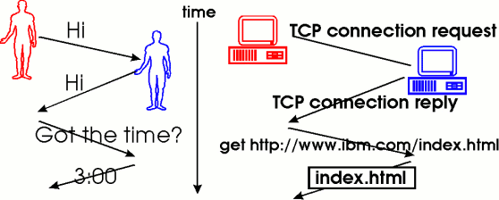
What is a Protocol ?
A protocol can be thought of as an ‘accepted standard’.
A protocol is a set of rules that the computers use over a network when they communicate.
These are rules accepted and followed by the network to successfully transmit data.
There are a host of protocols which allow users to communicate over the internet. Some of the important ones will be discussed in this chapter.
Diagram: Human protocol and a computer network protocol
Notes:
Source: https://www.net.t-labs.tu-berlin.de/teaching/computer_networking/01.02.htm

Slide 21
Transmission Control Protocol (TCP)
The Transmission Control Protocol provides reliable transmission of data in an IP environment.
Among the services it provides are:
Stream data transfer
Reliability
Efficient flow control
Full-duplex operation
Multiplexing
Notes:
1. Stream data transfer - TCP delivers an unstructured stream of bytes identified by sequence numbers. This service benefits applications because they do not have to chop data into blocks before handing it off to TCP. Instead, TCP groups bytes into segments and passes them to IP for delivery.
2. TCP offers reliability by providing connection-oriented, end-to-end reliable packet delivery through an internetwork. It does this by sequencing bytes with a forwarding acknowledgment number that indicates to the destination the next byte the source expects to receive. Bytes not acknowledged within a specified time period are retransmitted.
3. The reliability mechanism of TCP allows devices to deal with lost, delayed, duplicate, or misread packets. A time-out mechanism allows devices to detect lost packets and request retransmission.
4. TCP offers efficient flow control, which means that, when sending acknowledgments back to the source, the receiving TCP process indicates the highest sequence number it can receive without overflowing its internal buffers.
5. Full-duplex operation means that TCP processes can both send and receive at the same time.
6. Multiplexing means that numerous simultaneous upper-layer conversations can be multiplexed over a single connection.
Source: http://fab.cba.mit.edu/classes/961.04/people/neil/ip.pdf

Slide 22
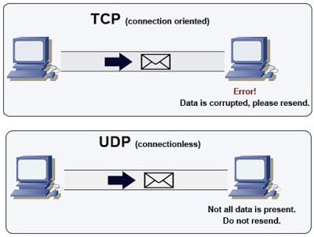
User Datagram Protocol (UDP)
The User Datagram Protocol is an alternative communication protocol to TCP.
It is a connection-less protocol that does not provide reliability, order or error-checking, but is much faster than TCP.
UDP is more suitable for real-time applications like video calls.
Diagram: TCP vs. UDP
Notes:
Source: http://www.java67.com/2016/09/difference-between-tcp-and-udp-in-java.html

Slide 23
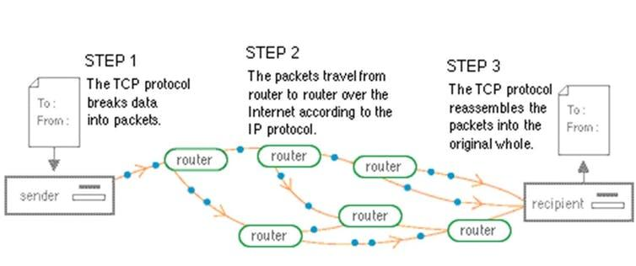
Internet Protocol (IP)
Internet Protocol (IP) has the task of delivering packets from the source host to the destination host solely based on the IP addresses in the packet headers.
Diagram: The Internet Protocol
Notes:
The postal system analogy:
Think of an analogy with the postal system.
The Internet Protocol is similar to the Postal System in that it allows a package (a datagram) to be addressed (encapsulated) and put into the system (the Internet) by the sender (source host). However, there is no direct link between sender and receiver.
The package (datagram) is almost always divided into pieces, but each piece contains the address of the receiver (destination host).
Eventually, each piece arrives at the receiver, often by different routes and at different times. These routes and times are also determined by the Postal System, which is the IP.
However, the Postal System (in the transport and application layers) puts all the pieces back together before delivery to the receiver (destination host).

Slide 24
IP Address
In the same sense that someone needs your mailing address to send you a letter, a remote computer needs your IP address to communicate with your computer.
There are two standards for IP addresses:
IP Version 4 (IPv4)
IP Version 6 (IPv6)
Notes:
IP addresses can be either static or dynamic.
Static IP Addresses never change. They serve as a permanent Internet address and provide a simple and reliable way for remote computers to contact you.
Static IP addresses reveal such information as the continent, country, region, and city in which a computer is located; the ISP (Internet Service Provider) that services that particular computer; and such technical information as the precise latitude and longitude of the country, as well as the locale, of the computer.
Dynamic IP Addresses are temporary and are assigned each time a computer joins a network. They are, in effect, borrowed from a pool of IP addresses that are shared among various computers.
Source: http://whatismyipaddress.com/ip-address

Slide 25
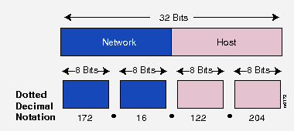
IPV4
An IPv4 address is expressed by four numbers separated by dots.
Each number is the decimal (base-10) representation for an eight-digit binary (base-2) number, also called an octet.
Diagram: IPV4 Address Format
Notes:
IPv4 uses 32 binary bits to create a single unique address on the network. When the Internet started most networks were private and closed off from other networks around the world. Therefore, having a 32-bit address with 4.3 billion possible addresses looked sufficient.
Figure Source: https://creatorscripts.blogspot.in/2014/07/how-to-get-geolocation-data-from-ip.html

Slide 26
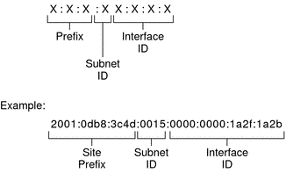
IPV6
The explosive growth in mobile devices including mobile phones, notebooks and other wireless handheld devices created the need for additional blocks of IP addresses.
IPv6 uses 128 bit addresses and offers 2¹²⁸ or approximately 3.4×10³⁸addresses.
Diagram: IPV6 Address Format
Notes:
IPv6 Addresses:
An IPv6 address is expressed by eight groups of hexadecimal (base-16) numbers separated by colons,
For example: 2001:cdba:0000:0000:0000:0000:3257:9652.
Groups of numbers that contain all zeros are often omitted to save space, leaving a colon separator to mark the gap (as in 2001:0dba::3257:9652). IPv6 and IPv4 share a similar architecture.
The majority of transport layer protocols that function with IPv4 will also function with the IPv6 protocol.
Figure Source: https://commons.wikimedia.org/wiki/File:Ipv4_address.svg

Slide 27
Name or Number!
which is easier to remember?

Slide 28
Domain Name System
“Domain Name is the name given for any website” (ex: yahoo.com).
“Domain Name System (DNS) is like a phone directory which stores all the domain names across the web“.
Notes:
As the internet grew so did the management issues associated with it.
One major issue was host addresses, to make it easy for people to use hosts were assigned names.
Originally, the number of hosts were limited so, it was feasible to maintain the host names and addresses in a table. Hence the Domain Name System was invented.
Figure Source: http://thehappylearning.com/what-is-domain-name-and-how-does-domain-name-system-dns-work/

Slide 29
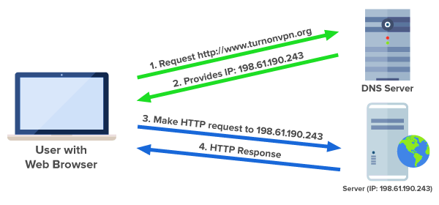
Domain Name Server
Domain Name Server(DNS) maps a domain name with its corresponding IP address.
Diagram: Domain Name Server
Notes:
Domain Name System:
Domain Name System (or Service or Server), an internet service that translates domain names into IP addresses. Because domain names are alphabetic, they are easier to remember. The Internet however, is really based on IP addresses. Every time you use a domain name, therefore, a DNS service must translate the name into the corresponding IP address.
For example, the domain name www.example.com might translate to 198.105.232.4.
The DNS system is, in fact, its own network. If one DNS server doesn't know how to translate a particular domain name, it asks another one, and so on, until the correct IP address is returned.
Source: https://www.webopedia.com/TERM/D/DNS.html
Figure Source: https://wwhttps://www.expressvpn.com/dns-leak-testw.expressvpn.com/dns-leak-test

Slide 30
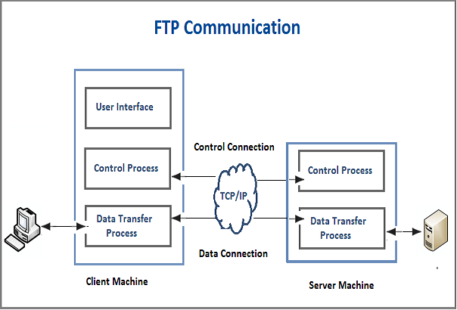
File Transfer Protocol (FTP)
The File Transfer Protocol is used to transfer files from one host computer to the other over a TCP/IP network. It creates two different connections – a control connection and a data connection.
The control connection is used for sending control information and the data connection is used for sending the actual file.
Port 21 is used for control connection whereas data connection uses port 20.
Diagram: File Transfer protocol
Notes:
File Transfer Protocol:
The client has three components namely :
The use interface
The client control process and
The client data transmission process.
The server has two components, they are:
Data transfer process
Server control process.
The control connection is made between the control processes to establish the connection between the server and the client.
The data connection is made between the transmission processes for actual file transfer.
During the whole interactive FTP session, the control connection remains active.
For each data transfer, the data connection is opened and closed after the transfer is complete.
If there are many files to be transmitted the data connection can be opened and closed multiple times.
Source: http://technet2u.com/file-transfer-protocol/

Slide 31
SMTP (Simple Mail Transfer Protocol)
The Simple Mail Transfer Protocol is used for sending e-mail messages between servers.
It uses the port 25.
SMTP because it is limited in its ability to queue messages at the receiving end, it is used with one of two other protocols – POP (Post Office Protocol) or IMAP (Internet Message Access Protocol) which allow the user to save the messages in a mailbox on the server and retrieve them when they want.
POP3 (Post Office Protocol)
This protocol is used by local e-mail clients to retrieve e-mail from the server.
It uses TCP port 110 to establish connection with the server and then it sends a request for a particular mailbox using user name and password.
The user can then retrieve the list of mail messages one by one. POP3 has two modes - Delete and keep. In the delete mode, mail is deleted from mailbox and in the keep mode, mail resides in the mailbox.

Slide 32
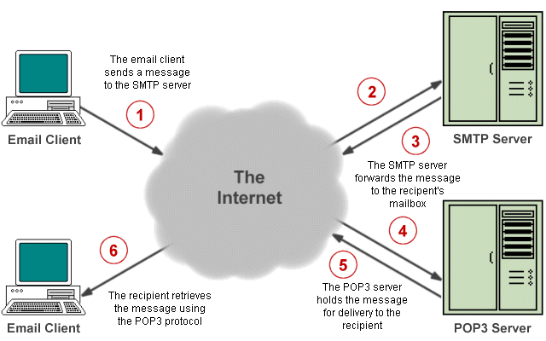
SMTP and POP3 Protocols
Diagram: SMTP and POP3 protocols
Notes:
The email works as follows:
1. The message is sent to the recipient's mailbox, which resides on a mail server, using the Simple Mail Transfer Protocol.
2. In order to deliver an email message, the client must establish a TCP connection to port 25 on the server.
3. The message is copied to the appropriate mailbox. If a message cannot be delivered, an error report containing the first part of the undeliverable message is sent to the sender.
4. POP3 (Post Office Protocol version 3) allows a user to log in to the server and retrieve messages from their mailbox, which are then stored on a local drive.
Interactive Mail Access Protocol(IMAP) :
By default, messages that have been downloaded to a recipient's computer are deleted from the server. The Interactive Mail Access Protocol(IMAP) is a more sophisticated mail protocol that stores all incoming and outgoing mail on the server so that mail clients with mailboxes on the server can access their e-mail from anywhere. Mail is not downloaded to the user's PC, and is only deleted from the client's mailbox if the client specifies that it is to be deleted.

Slide 33
Interactive Mail Access Protocol (IMAP)
By default, messages that have been downloaded to a recipient's computer are deleted from the mail server.
The Interactive Mail Access Protocol (IMAP) is a more sophisticated mail protocol that stores all incoming and outgoing mail on the server so that mail clients with mailboxes on the server can access their e-mail from anywhere.
Mail is not downloaded to the user's PC, and is only deleted from the client's mailbox if the client specifies that it is to be deleted.

Slide 34
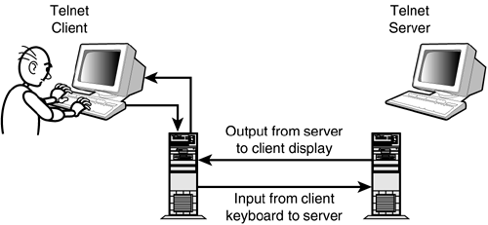
TELNET (Telecommunications Network)
Telnet is a remote login protocol.
The basic purpose of Telnet is to provide a means by which keyboard commands typed by a remote user can cross the network and become input for a different computer. Screen output related to the session then crosses the network from that different computer (the server) to the client system.
However, because of security issues its use over public internet should be avoided.
Diagram: Telnet Protocol
Notes:
Source: http://www.yaldex.com/tcp_ip/0672325659_ch15lev1sec1.html

Slide 35
Is the Internet same as the World Wide Web?

Slide 36

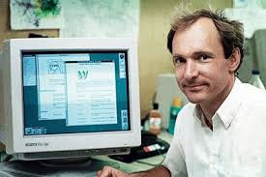
The web was born at CERN in Geneva in 1990, to allow its researchers who were geographically dispersed to share documents using a hypertext system.
Tim Berners Lee
Father of World Wide Web
36
Notes:
CERN – the European Organization for Nuclear Research

Slide 37
The web is not the same as the internet, it is a service provided by
the internet.
The World Wide Web is a system of interlinked hypertext documents accessed via the internet.

Slide 38
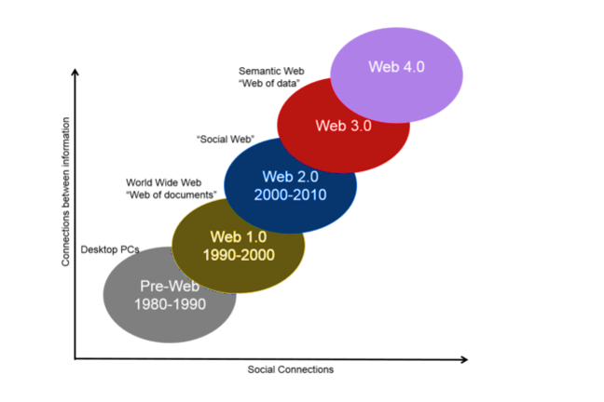
History of the Web
Diagram: World Wide Web Timeline
Notes:
1. Personal computers ruled in the 80’s.
2. In 1990-2000 the web was just static pages with links, it was web 1.0.
3. The next decade was the era of social web - web 2.0 – blogs, Facebook , YouTube etc.
Source: https://www.futurelearn.com/courses/linked-data/0/steps/16078

Slide 39
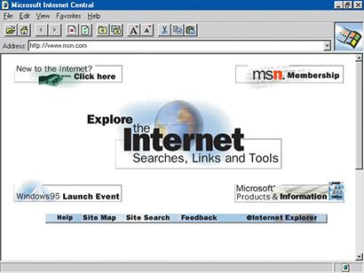
Web 1.0
Diagram: Internet Explorer web page from 1995
Notes:
1. Mostly static web pages.
2. Text, images and hyperlinks.
3. Mostly read-only. Readers were unable to contribute.
Source: https://www.pastemagazine.com/articles/2015/03/rip-internet-explorer-the-rise-and-fall-of-an-empi.html
1. Personal computers ruled in the 80’s.
2. In 1990-2000 the web was just static pages with links, it was web 1.0.
3. The next decade was the era of social web - web 2.0 – blogs, Facebook , YouTube etc.
Source: https://www.futurelearn.com/courses/linked-data/0/steps/16078

Slide 40




Web 2.0
Notes:
1. Web pages became dynamic.
2. Read/Write Web. Users were allowed to contribute.
3. It is called the social web since social media like Facebook became widespread during this time.
4. Blogs and wikis.
Technologies used:
Server side: Perl, PHP, Ruby, JSP etc.
Client side: JavaScript, Ajax, Flash, Flex

Slide 41
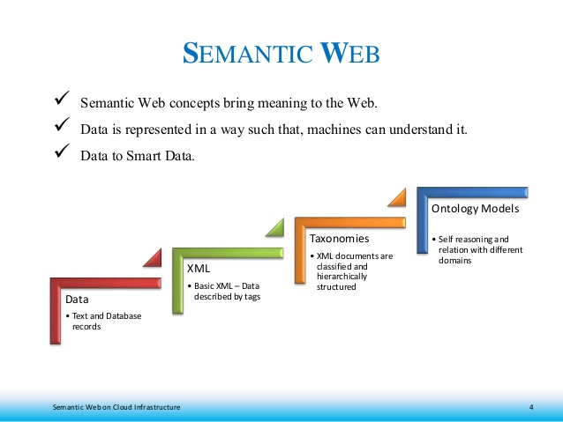
Web 3.0
Diagram: The Semantic Web
Notes:
1. Semantic web – web where information is well defined.
2. Smart applications
3. Cloud
4. Ontologies
5. Taxonomies
Figure Source: https://www.slideshare.net/thurupathan/semantic-web-on-cloud-infrastructure

Slide 42
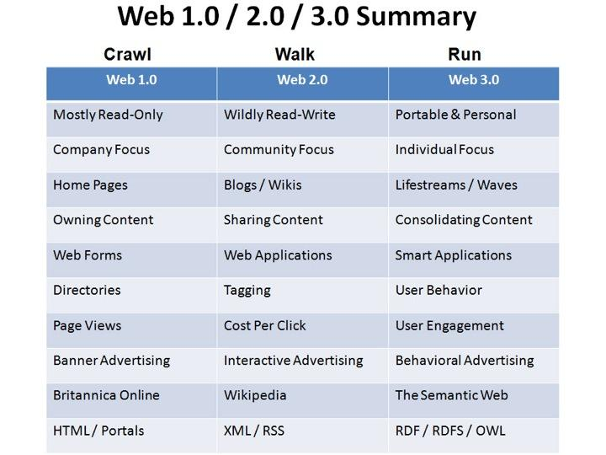
Notes:
Source: https://ashiqinyusof94.wordpress.com/2016/04/24/the-major-differences-among-web-1-0-web-2-0-and-web-3-0/

Slide 43
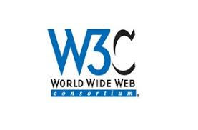
The World Wide Web Consortium
In 1994, Tim Berners-Lee with the help of Massachusetts Institute of Technology founded the World Wide Web Consortium (W3C), an international community which is devoted to developing ‘Open web standards’.
The W3C describes itself as,
“The World Wide Web Consortium exists to realize the full potential of the web”

Slide 44
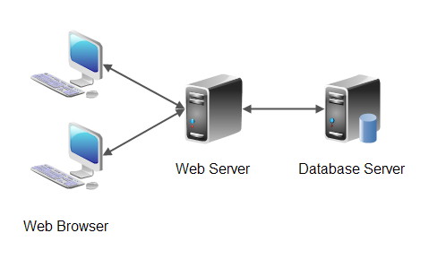
Web Architecture
Diagram: The Web Architecture
Notes:
The web is based on the client-server architecture. It consists of the web browser on the client side and a web server on the server side. The communication is done using the Hyper Text Transfer Protocol.
Figure Source : Source: http://tutorials.jenkov.com/software-architecture/n-tier-architecture.html

Slide 45
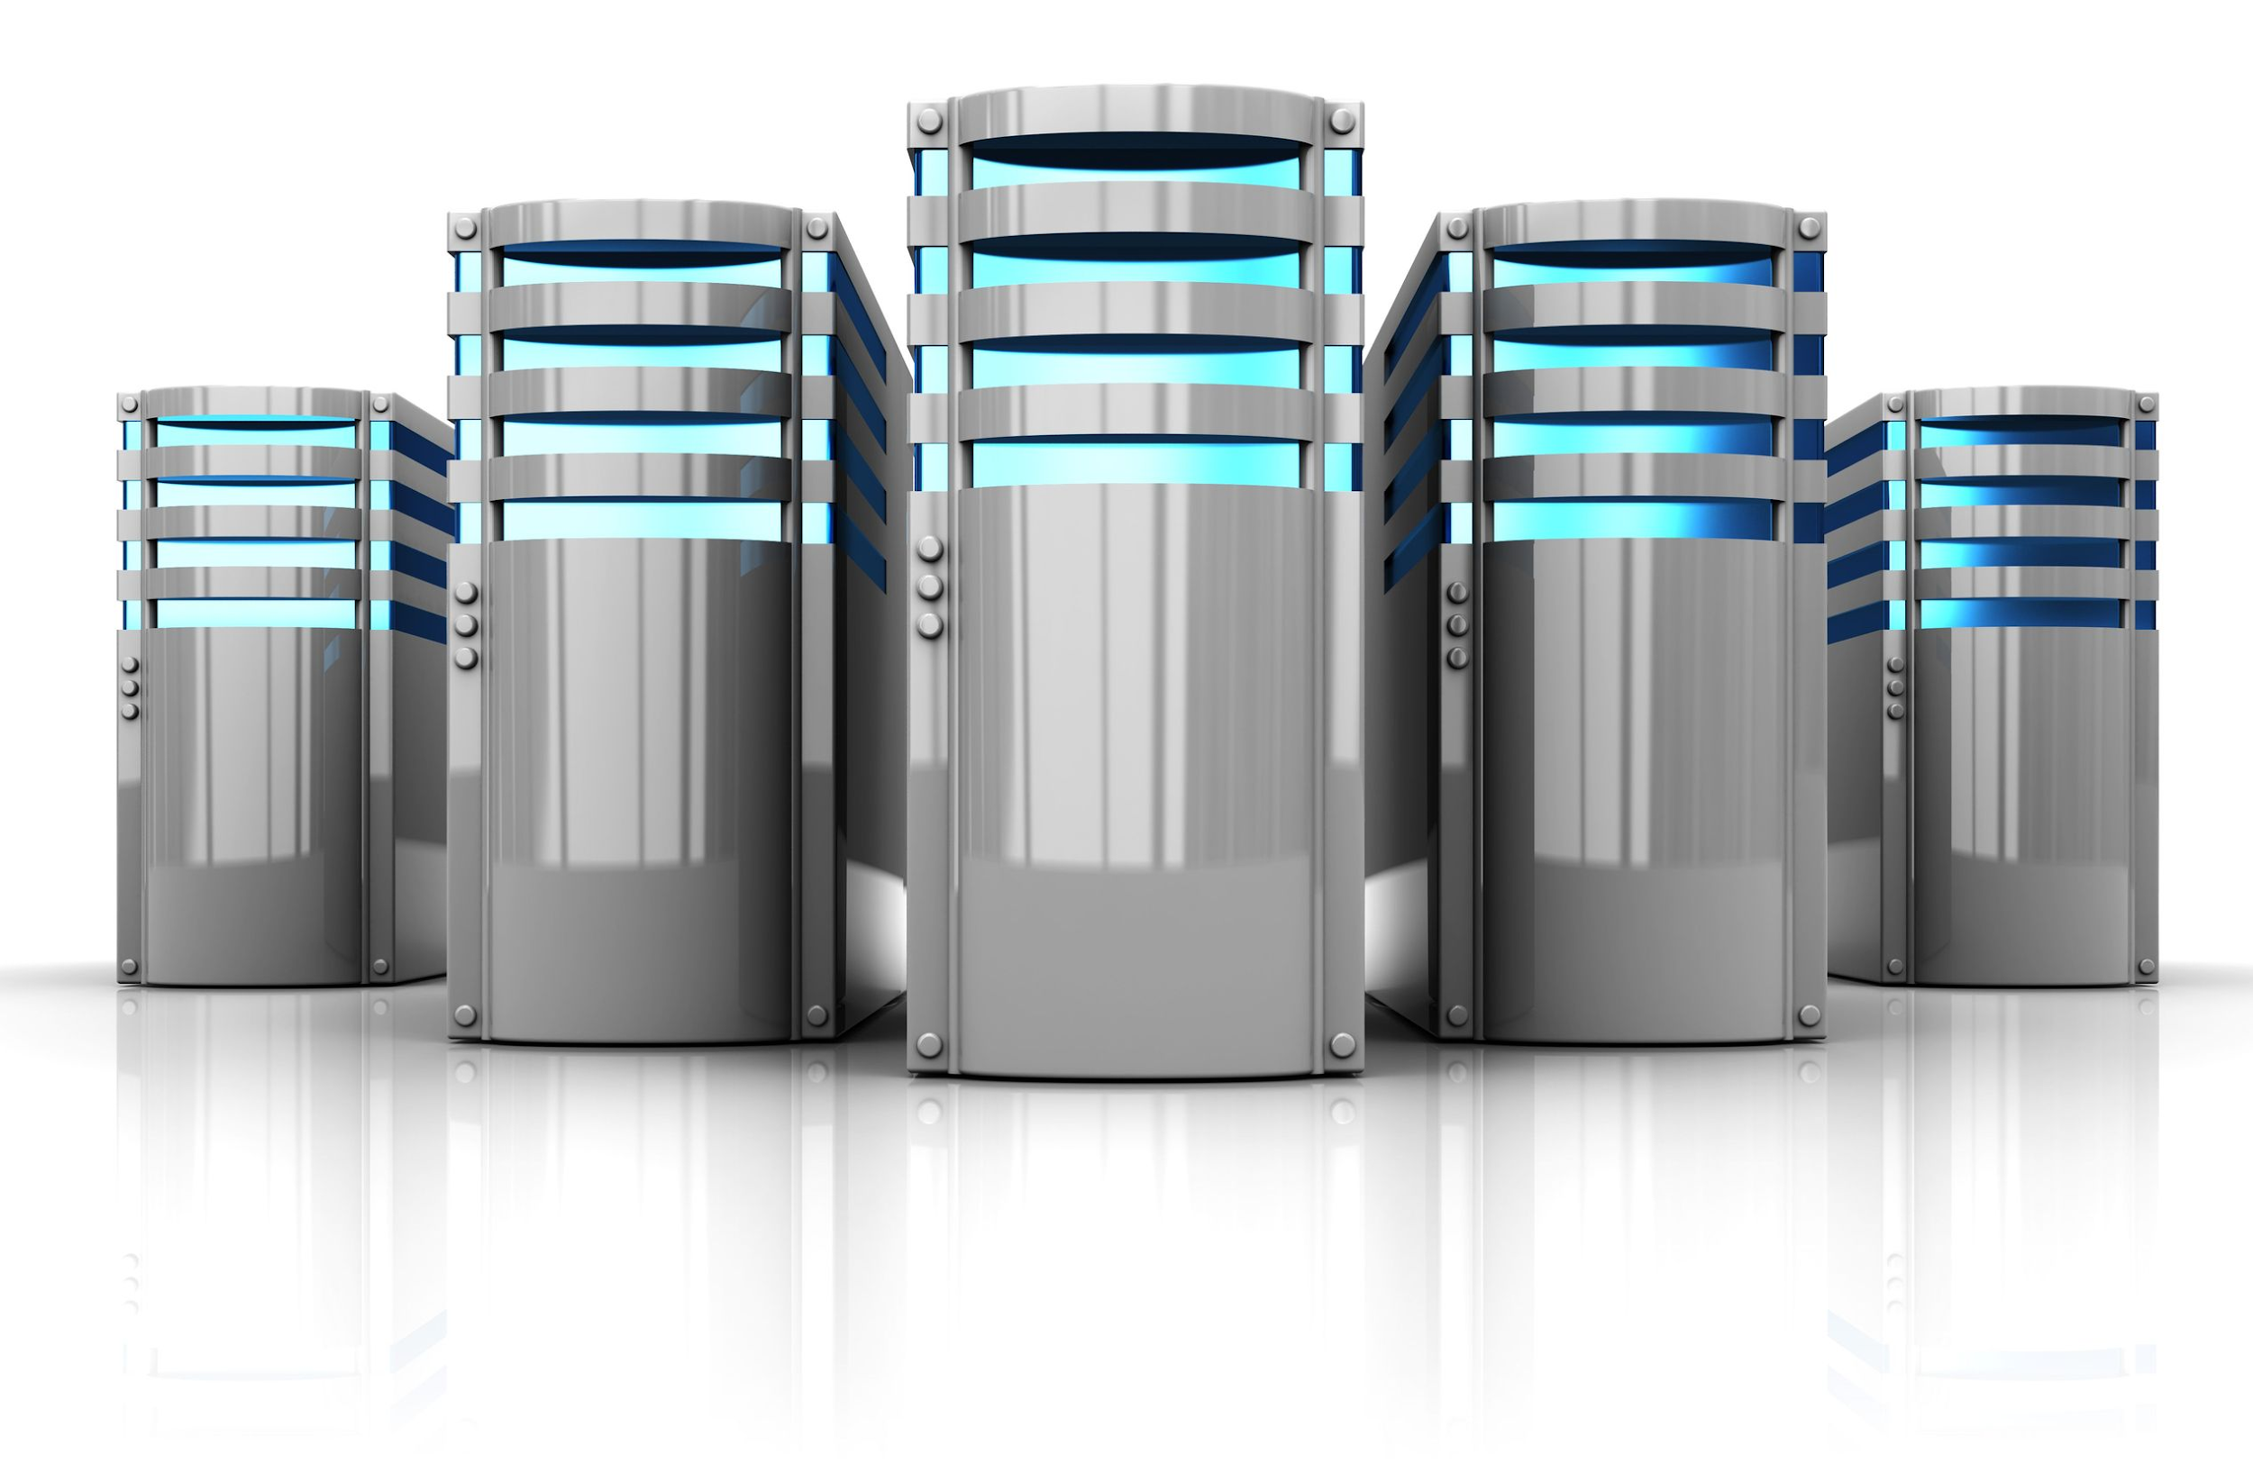
Web Server
A web server can be both software and hardware.
It is a program that responds to the requests made by the client.
A computer where the websites are hosted or stored can also be called as a web server.

Slide 46
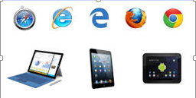
Web Clients
A web client can be both software and hardware.
A web client is an application that communicates with a web server, using Hypertext Transfer Protocol (HTTP).
A Web client contains two parts: dynamic Web pages and the Web browser.
Dynamic Web pages are produced by components that run in the Web tier, and a Web browser delivers Web pages received from the server.

Slide 47
Unified Resource Identifier (URI)
The web servers host web resources.
A web resource is a content source, it can be anything from a static file, a live image from a camera or dynamic content resources.
Each web server resource has a name to identify the resource uniquely called the ‘Uniform Resource Identifier’ or URI.
For example:
Below is an example of an image resource URI.
http://www.example.com/specials/polar.gif

Slide 48
The Uniform Resource Identifier has two forms:
Uniform Resource Locator
Uniform Resource Name

Slide 49
Unified Resource Locator (URL)
Uniform Resource Locator is the most common form of resource identifier.
A URL defines the specific location of the resource on a particular server.
Example: http://www.yahoo.com/images/logo.gif is the URL for the Yahoo! Website’s logo.
http://
Scheme
www.yahoo.com
Address
/images/logo.gif
Resource location
Notes:
A URL has a standard format of three parts:
1. The first part is called the scheme and describes the protocol being used for access, this is usually HTTP protocol (http://).
2. The second part gives server internet address (www.yahoo.com).
3. The last part identifies the resource location on the web server (/images/logo.gif).

Slide 50
Unified Resource Name (URN)
Uniform Resource Name serves as a unique name to a resource irrespective of the location where it resides.
Being location-independent these resources can move freely and can be accessed by multiple network access protocols.
Uniform Resource Names are still in experimental stage and not yet widely adopted.
For example,
The Uniform Resource Name urn:ietf:rfc:2141 can be used to name the internet standards document “RFC 2141”.

Slide 51

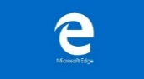
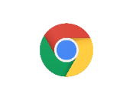


Web Browser
A web browser is an application program used to request, view and traverse the web pages.
It can display information in the form of text, images, multimedia and more.
We can upload or download files using the browser.
Notes:
1. Google Chrome - Google's Chrome browser is speedy, includes leading standards support, strong security features, and a clean interface.
2. Mozilla Firefox - Firefox can't be beat when it comes to customizability and features. It's also fast, secure, and protects your privacy.
3. Opera - Opera is a web browser for Windows, mac OS, and Linux operating systems developed by Opera Software. It uses the Blink layout engine.
4. Microsoft Edge - Microsoft Edge is a web browser developed by Microsoft and included in Windows 10, Windows 10 Mobile and Xbox One, replacing Internet Explorer as the default web browser on all device classes.
5. Vivaldi - Vivaldi is a freeware, cross-platform web browser developed by Vivaldi Technologies, a company founded by Opera Software co-founder and former CEO Jon Stephenson von Tetzchner and Tatsuki Tomita.

Slide 52
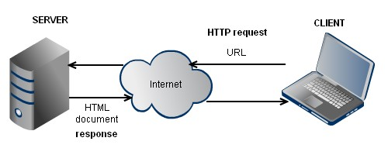
Hyper Text Transfer Protocol
Hyper Text Transfer Protocol or HTTP is the protocol that is used to enable a web browser and a web server to communicate.
The Hyper Text Transfer Protocol
Notes:
Hyper Text Transfer Protocol (HTTP):
HTTP is the protocol that enables a web browser and a web server to communicate.
2. HTTP or the Hyper Text Transfer Protocol can be defined as a connectionless and stateless, application layer protocol using which all the web browsers, servers and web applications communicate with each other.
3. HTTP supports various network configurations and allows communication between different hosts and clients.
4. The communication usually happens over TCP/IP, by default it uses port 80 on the TCP/IP but other ports can also be used.
5. It is also media independent which means any type of data can be sent by HTTP like text, images, multimedia and hyperlinks.
6. HTTP uses reliable data transmission protocols and hence guarantees that the data is not damaged in transit.
Figure Source: http://www.tankonyvtar.hu/hu/tartalom/tamop425/0027_ADW1/ch01s02.html

Slide 53
HTTP Kitchen Analogy
Hyper Text Transfer Protocol
Eating in a Restaurant
Suppose I want to access a web page like www.example.com/myvideos/vid1.
The HTTP protocol uses the URL to identify the server, it makes a connection and sends the request to the server and terminates the connection.
The server receives the request and checks if the requested resource is available, if so it reestablishes the connection with the client and sends the response.
The browser can make multiple requests and each request is processed independent of the previous requests.
The first thing you need to do is find the restaurant you want to eat from.
Once in the restaurant you would send an order to the kitchen for whatever you like to eat.
The kitchen checks to see if the ordered item is available, if yes it is delivered to you on your table.
You can make multiple orders while in the restaurant and the kitchen while processing a given order does not keep in mind what your previous orders were.

Slide 54
HTTP Client-Server Model
HTTP Request
Client
Server
HTTP Response
Notes:
The HTTP communication uses the client server model.
The communication between a client and server happens via a request/response pair.
Web content is stored on the web servers, the client when it requires some information initiates an HTTP request and the server services this request using a HTTP response. It is also called the request response protocol.

Slide 55
HTTP MIME(Multipurpose Internet Mail Extensions) Types
Document | MIME type
HTML formatted text document | text/html
Plain ASCII text document | text/plain
JPEG version | image/jpeg
GIF format | image/gif
Apple quick time movie | video/quicktime
Microsoft power point presentation | application/vnd.ms-powerpoint
Notes:
Since there are thousands of different data type on the web, HTTP tags each object being transported with a data format label called the MIME (Multipurpose Internet Mail Extensions) type. The above table shows some of the MIME types.

Slide 56
HTTP Transaction
Method URI HTTP version
HTTP version Status code
Start line
Name1: value1
Name2: value2
Name3: value3
Name1: value1
Name2: value2
Name3: value3
Headers
Requested Resource
Body
Request Message
Response Message
HTTP Message Formats
Notes:
Suppose I request for the web page www.example.com/index.html and as a result the request page was displayed on my browser. The exchange between the browser and the server is called a HTTP transaction. It consists of a request command and a response result.

Slide 57
Using the format let us write request and response messages for our index.html example.
Request Message
Response Message
GET /index.html HTTP 1.0
Host: www.example.com
Accept: text/html
Accept-language: en-us
HTTP 1.0 200 : OK
Host: www.example.com
Accept: text/html
Accept-language: en-us
index.html
Request and Response Messages
Notes:
The request/response message has three sections – start line, headers and an optional body. The start line in a request message consists of:
A method to tell the server the type of request being made.
The URI of the resource.
The client’s HTTP version.
The start line in the response message contains:
The HTTP version.
A status code to indicate whether the request has been successful or an error has occurred.
Headers are a set of name: value pairs separated by a colon for easy parsing which provide information such as the host name, language accepted and the MIME type.
The Body of the message contains any kind of data that is carried from client to server and server to client. Unlike the start line and header which are textual and structured, the body can contain any type of binary data like text, images, videos, audio and software applications.

Slide 58
HTTP Methods
Method | Description
GET | Used to get a named resource from the server using URI.
PUT | Replace all representations of the resource with the new upload.
POST | Used to send data to the server like customer information using HTML form
DELETE | Deletes the resource from the server
HEAD | Similar to GET, but transfers the status line and header section of the message
CONNECT | Establishes a connection with the server identified by the URI
Notes:
HTTP supports many request commands, called HTTP Methods. Every HTTP message has a method which indicates the action to be performed.

Slide 59

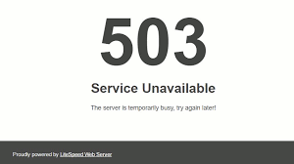
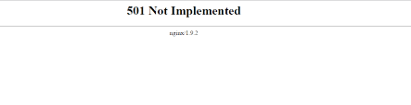
The HTTP Status Codes
Notes:
Every HTTP response message contains a status code. It is a three-digit numeric code that tells the client whether the request succeeded. Some of the common codes are:
1. A code like 1xx indicates that the request has been received and being processed. For example, the code 100 means,
Continue - the request has been only partially received by the server but as long as the request is not rejected by the server, the client must continue with the request.
2. A code like 2xx implies the action was received, understood and accepted. For example, code 201 means,
Created - the request is complete, a new resource was created.
3. A code like 3xx indicates further action is required to complete the request. For example 302 means,
Found – The requested resource has been moved to a new URL temporarily.
4. A code like 4xx means an incorrect syntax or request cannot be fulfilled. For example, 404 means,
Not Found – the server cannot find the requested page.
5. A code like 5xx means the request was valid but the server failed to fulfill it. For example, 503 means,
Service Unavailable – request not complete, the server is down.

Slide 60
Web Application
A Web application (Web app) is an application program that is stored on a remote server and delivered over the Internet through a browser interface.
It can be:
Static Web Application
A collection of related web pages that may contain text, links, audio, images and videos.
It requires only client-side processing.
Dynamic Web Application
A dynamic web application is interactive.
They can automatically update different sections based on information from other applications or databases. Users see different inputs based on the input given.
Dynamic web applications require back-end processing in addition to client-side processing.
Facebook app is an example of dynamic web application.

Slide 61
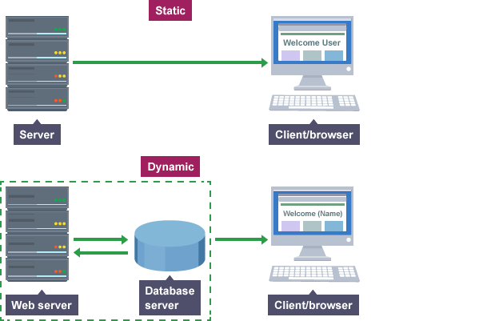
Static and Dynamic Web Applications
Diagram: Static vs. Dynamic Web Applications
Notes:
Source: https://www.bbc.co.uk/education/guides/znkqn39/revision

Slide 62
Front-end and Back-end Web Development
The web development functions can be categorized into five areas:
Preparing page structure.
Organizing and managing content hierarchy.
Serving content to the user.
Capturing user input.
Performing back-end processing and integration.
Different web technologies are required to accomplish these functions. Web development can be divided into two categories:
Front-end Web Development
Back-end Web Development

Slide 63
Front-end Development is also called the client-side development
It is used for developing what the user sees when they open a website or load a web application.
It is used to develop the structure and design of websites.
Back-end development - Most of the code that makes a web application work is on the back-end.
The back-end code runs on the server therefore, a back-end developer must have a good understanding of the programming languages, database and server architecture.
The server-side programming can be divided into four main components:
The Servers
Databases
Middleware
Programming languages and framework.
Notes:
The Servers – it provides the shared resources required by the networks to run like file storage, databases, web services and security. Understanding the server architecture is important in order to program the back-end.
Databases – databases store the data required by the website and allows the users to search and retrieve what they want.
Middleware – a software that connects the application’s front-end to its back-end.

Slide 64
Web Technologies
Web technologies is a general term referring to the many languages and multimedia packages that are used in conjunction with one another, to produce dynamic web sites. Some of the important technologies are:
Hyper Text Markup Language (HTML) - HTML is the standard markup language for creating web pages and web applications.
Cascading Style Sheets (CSS) - the Cascading Styling Sheets is used to style an HTML document.
JavaScript - It is a dynamic programming language which when applied to a HTML document can make the websites interactive with the user.
Extensible Markup Language (XML) - it is an extensible language which can be used to create specific mark-up languages such as chemical mark-up.
ASP.NET - ASP .NET is a web framework for building dynamic web sites, web applications and web services.
Notes:
Hyper Text Markup Language
HTML is the standard markup language for creating web pages and web applications.
A markup language is designed to process, define and present text. The HTML describes the structure and organization of web pages.
HTML elements form the basic building blocks of the web.
A few examples of structuring using HTML are creating paragraphs, including images and links, headings, line breaks, tables and lists.
Cascading Style Sheets
Apart from being structured a website requires styling if it has to be visually appealing. CSS or the Cascading Styling Sheets are used to style an HTML document.
Example: the background color of a page, defining a common font size and type for a particular section, add animations and other decorative features.
Java Script
HTML and CSS together can create static websites which are good only for displaying information to the user.
If you want to make your page interactive, for example, add games, response to a button press and animated 2D and 3D graphics. Java Script is the language which can provide this interactivity.
It is a dynamic programming language which when applied to a HTML document can make the websites interactive with the user.
It was invented by Brendan Eich, co-founder of Mozilla.
XML – eXtensible Markup Language
As the name suggests it is an extensible language which can be used to create specific mark-up languages such as chemical mark-up.
It is a subset of Standard generalized markup Language (SGML) but with less complexity.
ASP .NET
ASP .NET is a web framework for building dynamic web sites, web applications and web services.
It provides a very good integration of HTML, CSS and Java Script.

Slide 65
Web Technologies
Servlets – It is a server-side programming language. An efficient and powerful solution for creating dynamic web content.
Java Server Pages (JSP) - The Java Server Pages is a server-side technology that is used to create dynamic web pages based on HTML, XML or other document types. Java code is inserted into HTML using JSP tag <% ----Java code----%>.
Hypertext Preprocessor (PHP) - PHP is an open source general purpose scripting language for server-side development. It can be embedded in HTML.
Asynchronous JavaScript And XML (AJAX) - AJAX is not a programming language in itself. It uses the XMLHttpRequest object to request data from the server and java script and HTML DOM to display or use the data. The most appealing characteristic of the AJAX is that it can communicate with the server, exchange data and update a page without even refreshing the page.
Notes:
Java Server Pages
The Java Server Pages is a server-side technology that is used to create dynamic web pages based on HTML, XML or other document types.
Java code is inserted into HTML using JSP tag <% ----Java code----%>. It is an expression language which can be used to access server-side objects.
PHP – Hypertext Preprocessor
PHP is an open source general purpose scripting language for server-side development. It can be embedded in HTML. It is a powerful language since it can interact with many different kinds of databases such as MySQL. An example of a PHP is the script that displays the date on your web page.

Slide 66

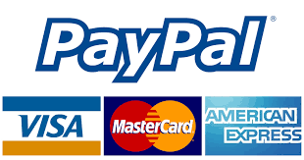
Web Services analogy
Consider the aircraft reservation software,
In addition to doing reservations, the software also requires to communicate with e-commerce sites like PayPal for payments made online.
But we know that the reservation system and the PayPal software are separate systems written in different languages.
Communication between the two heterogeneous software systems happens through a special kind of web application known as a web service.
Web Services
Airline Reservation Software Service Requester
PayPal Software Service Provider
Notes:
An organization may use multiple software systems for management.
These software systems often need to exchange data with each other a web service allows the software systems to communicate over the internet.
The software system that makes the request is called “Service requester” and the software system which responds to the request is called the “Service Provider”.
Since different software systems use different programming languages it is necessary that the method of data exchange between the two should not be dependent on any particular programming language.
However, most types of software are capable of interpreting XML tags therefore, web services can use XML files for exchange of data.

Slide 67
Web Services
Web service is a service offered by one electronic device to another via the World Wide Web.
The W3C defines a web service as,
‘A web service is a software system designed to support interoperable machine-to-machine interaction over a network.’

Slide 68
Web Service Components
SOAP – Simple Object Access Protocol
REST – Representational State Transfer
WSDL – Web Services Description Language
UDDI – Universal Description, Discovery and Integration

Slide 69
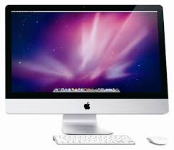
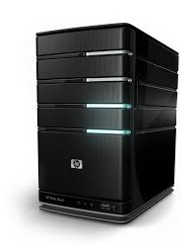
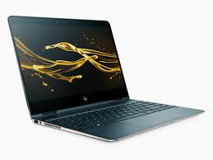
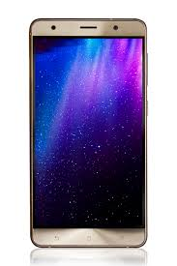

SOAP – Simple Object Access Protocol
SOAP is an XML based messaging protocol which allows programs running on different operating systems such as Windows and Linux to communicate using HTTP and XML.
Web server hosting the various web services
Consume Data
HTTP
SOAP over HTTP request
Consume Data
HTTP
XML based response
HTTP
INTERNET
Consume Data
SOAP – accessing web services
Notes:
SOAP uses HTTP and XML. This is because all major operating system platforms are installed with web protocols.
HTTP and XML act as the common tools using which the communication can happen.
SOAP specifies how the HTTP header and the XML file should be encoded so that a program in one computer to call a program on another computer.
It also specifies how the called program can respond to the request. Though it is often paired with HTTP, SOAP support other transport protocols like SMTP and others.
SOAP calls are more likely to get through firewalls, this is because they use HTTP and HTTP requests are usually allowed through firewalls.

Slide 70
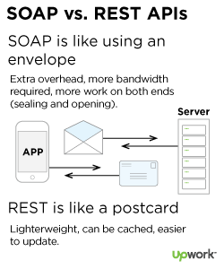
REST – Representational State Transfer
REST was defined by Roy Fielding in 2000.
REST is an architectural style for developing web services. It uses HTTP for accessing resources, but unlike SOAP the web service developed using REST are light weight and use less bandwidth.
Notes:
Source: https://www.upwork.com/hiring/development/soap-vs-rest-comparing-two-apis/

Slide 71
REST – Representational State Transfer
REST defines a way of accessing resources such as documents, pictures or videos which reside on a different environment.
The key elements of RESTful implementation are:
Resources – the resource itself.
Request Verbs – to describe what to do with the resource. The verbs include GET, POST, DELETE, PUT.
Request Header – additional information such as authorization details.
Request Body – contains Data, usually sent when POST is used.
Response Body – an XML document with the data.
Response Status Codes – returned with the response indicating whether there is any error or response has been sent.

Slide 72
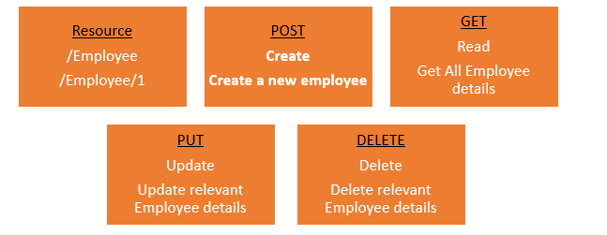
REST - Example
Let us assume a RESTful web service is defined at a particular location. The client can use any HTTP verbs to make the request. For Example,
POST – This would be used to create a new employee using the RESTful web service
GET - This would be used to get a list of all employee using the RESTful web service
PUT - This would be used to update all employee using the RESTful web service
DELETE - This would be used to delete all employee using the RESTful web service
Request Verbs on a single employee record
Notes:
Consider one single record , the actions performed would be:
POST – This would not be applicable since we are fetching data of employee 1 which is already created.
GET - This would be used to get the details of the employee with Employee no as 1 using the RESTful web service.
PUT - This would be used to update the details of the employee with Employee no as 1 using the RESTful web service.
DELETE - This is used to delete the details of the employee with Employee no as 1.
Source: https://www.guru99.com/restful-web-services.html

